Slide 1
SAP ABAP/4
Advanced Business Application Programming
Data Dictionary

Slide 2
Data Dictionary
Overview
Tables
Table Maintenance Generator
Handling Currency and Quantity
Views
Data Elements
Domain
Foreign key Relationship
Database Utility
Structures
Table Types
Search Helps
Lock Objects
Type Groups

Slide 3
Data Dictionary
Data Dictionary
Overview
DDIC creates and manages data definitions globally
Different components of SAP R/3 system can access them.
New or modified data definitions will be automatically available to all the programs of the SAP R/3 system.
This ensures data integrity, data consistency and data security. Thus it avoids redundancy.
Transaction Code: SE11
Domain
Data Elements
Tables
Table Maintenance
Views
Search Help
Lock Objects
Structure

Slide 4
Data Dictionary
Domain
Overview
Domain
It describes the technical properties such as data type and length.
Also defines the list of values which helps the user to enter the data among this list range
A single domain can be used for many fields.
Properties of Domain:
Data Type
Length
Decimals (For Numerical Fields)
Output Length
Fixed Values
Value Range
Value Table
Data Elements
Tables
Table Maintenance
Views
Search Help
Lock Objects
Structure

Slide 5
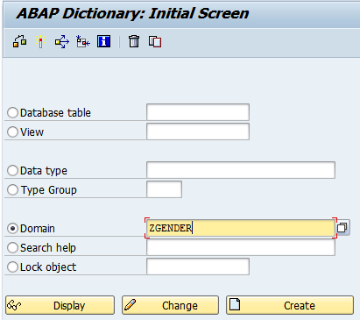
Domain
1. Select “Domain” Radio Button
2. Enter Domain Name
3. Click on Create Button

Slide 6
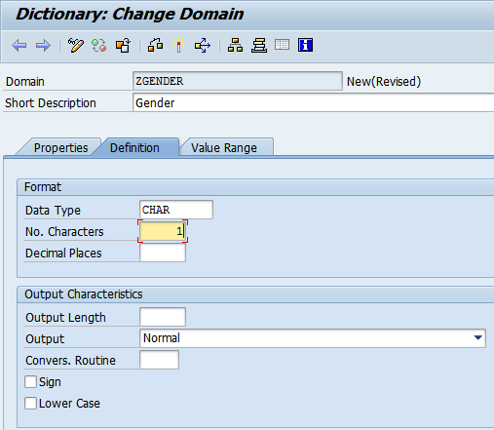
Domain
4. Enter Description
5. Select Definition Tab
6. Enter Data Type and Length

Slide 7
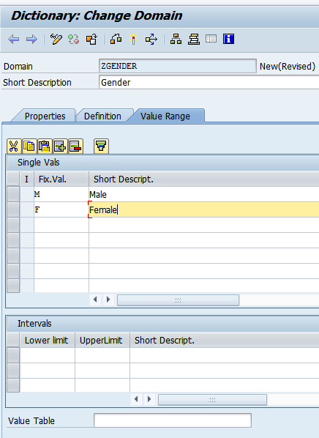
Domain
7. Select Value Range Tab
8. Enter set of Fixed Values/Ranges/Value Table

Slide 8
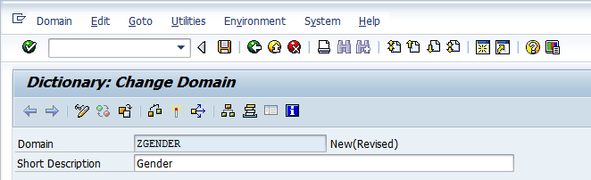
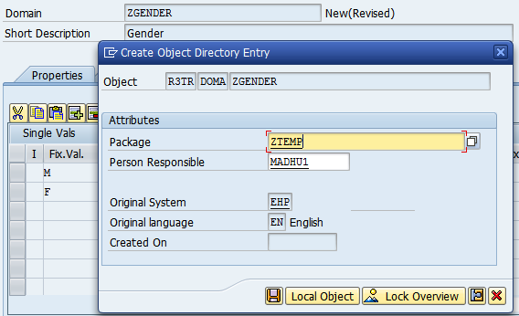
Domain
9. Click on Save Button
10. Enter Package

Slide 9
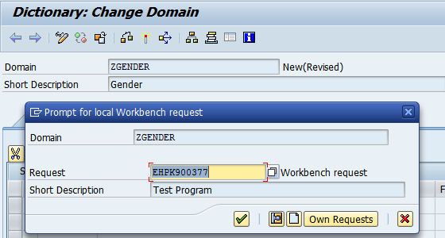
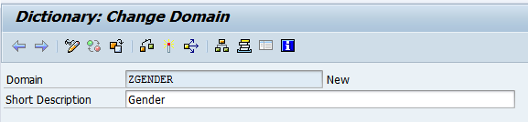
Domain
11. Enter Transport Number
12. Check for syntax errors
13. Activate

Slide 10
Data Dictionary
Data Element
Overview
Domain
It contains field labels and online documentation along with technical properties.
Field labels provided in data elements will be displayed as a label for a screen field. When the user press F1 function key on the screen field then a help documentation will be displayed for the user from data element.
Properties of Data Elements
Data Type: It can be Domain or Predefined Type
Field Label: it will help us to enter Label for the field in various lengths
Further Characteristics: Help us to assign search help and Parameter IDs
Data Elements
Tables
Table Maintenance
Views
Search Help
Lock Objects
Structure

Slide 11
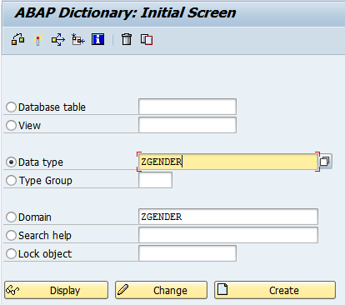
Data Element
1. Select Data Type Radio Button
2. Enter Data Element Name
3. Click on Create Button

Slide 12
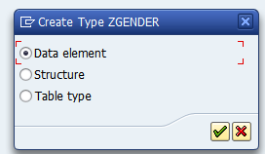
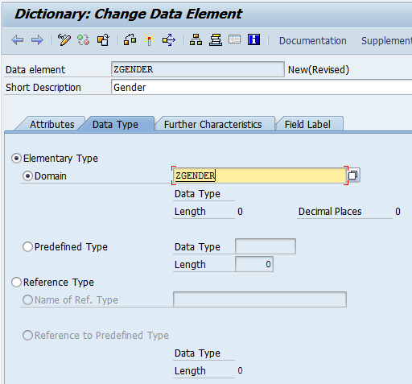
Data Element
4. Select Data Element Radio Button
5. Enter Description
6. Select Data type Tab
9. Enter Domain Name
7. Select Elementary Type Radio Button
8. Select Domain Radio Button

Slide 13
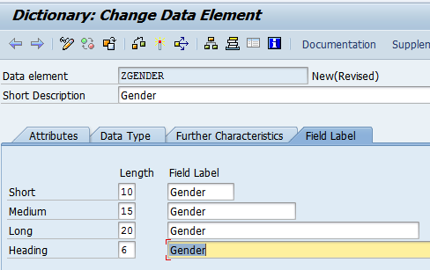
Data Element
10. Select Field Label Tab
11. Enter all Descriptions
Short, Medium, Long and Heading
12. Save
13. Syntax Check
14. Activate

Slide 14
Data Dictionary
Tables Overview
Overview
Domain
Structure or definition of database table is created and with this structure of physical database table is created in the underlying database system.
Table Properties:
Delivery and Maintenance
Fields and its Properties
Key
Currency and Quantity
Help
Technical Settings
Indexes
Append Structures
Data Elements
Tables: Overview
Table Maintenance
Views
Search Help
Lock Objects
Structure

Slide 15
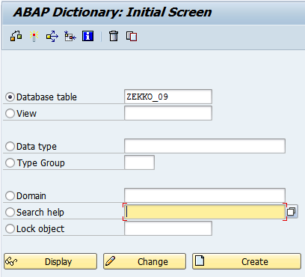
Tables
Overview
1. Select Database table Radio Button
2. Enter Database table Name
3. Click on Create Button

Slide 16
Tables
Delivery and Maintenance
Data Dictionary
Overview
Delivery
It specify what kind of data we want to store in the table
A – Application Data
It can be Master Data or Transaction Data
C – Customizing Data
Configuration Data
There are other Categories as well
Browser and Maintenance Type:
To enable of disable maintenance of the entries in the table
Using SM30
Allowed: Display and Maintenance Allowed
Allowed with Restriction:
Not Allowed: Not allowed to display as well from SE16
Domain
Data Elements
Tables: Delivery and Maintenance
Table Maintenance
Views
Search Help
Lock Objects
Structure

Slide 17
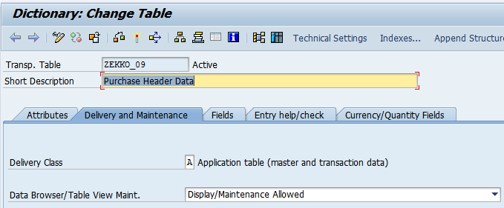
Tables
Delivery and Maintenance
5. Select Delivery and Maintenance Tab
4. Enter short Description
6. Specify Delivery Class
7. Choose Data browser/Table Maintenance

Slide 18
Data Dictionary
Tables
Fields
Overview
Domain
Fields: Field are columns in the table.
Specify following
Field Name
Key Specification
Data Type & Length
Foreign Key relationship
Search Help assignment
Data Elements
Tables: Fields
Table Maintenance
Views
Search Help
Lock Objects
Structure

Slide 19
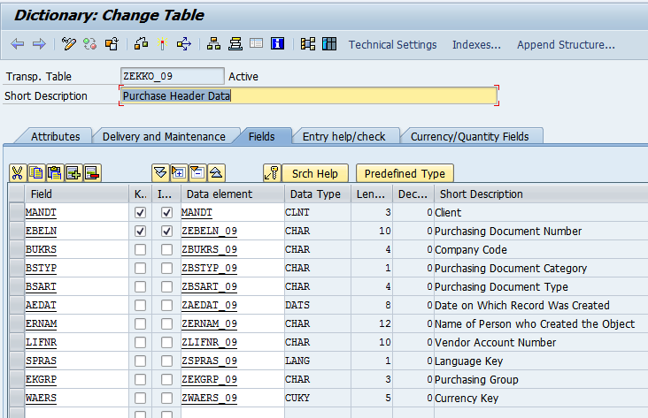
Tables
Fields
8. Select Fields Tab
9. Enter Field Name
Select Key Field Check box if required
Select Initial Check if required
Specify Data Element
Repeat the steps from 9th to 12th Steps for each field

Slide 20
Data Dictionary
Tables
Key specification for the field
Overview
Domain
Searching:
It is a method for finding a particular value in a list
Linear Search
It checks each element in sequence until the desired element is found or the list is exhausted.
The list need not be ordered.
Binary Search
It divides a range of values into halves, and continues to narrow down the field of search until the unknown value is found
The list should be in Sorted Order
Data Elements
Tables: Key specification
Table Maintenance
Views
Search Help
Lock Objects
Structure

Slide 21
Data Dictionary
Tables
Technical Settings
Overview
Domain
Technical Setting: Buffering
It speeds of the data access by temporarily stores the more frequently accessed data in the buffer. i.e. In the memory of application server.
There are 3 buffering types are there
Single Buffering: It will buffer only one record
Generic Buffering: It will buffer multiple records based on key fields
Full Buffering: it will buffer all the accessed records
Data Elements
Tables: Technical Settings
Table Maintenance
Views
Search Help
Lock Objects
structure

Slide 22
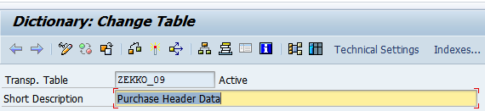
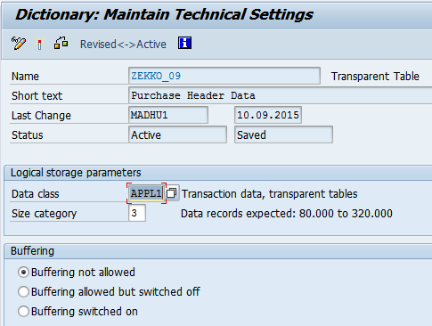
Tables
Technical Settings
14. Select Technical Setting Button
15. Specify Data Class
16. Specify size category
17. Specify Buffering option if required
18. Specify Buffering type if Buffering switched on
19. Save , Syntax Check and Activate

Slide 23
Tables
Quantities and Currencies Handling
Data Dictionary
Overview
Domain
Quantity:
If table has field having data type ‘QUAN’
then specify reference table and reference field which is having data type ‘UNIT’
Currency:
If table has field having data type ‘CURR’
then specify reference table and reference field which is having data type ‘CUKY’
Data Elements
Tables: Quantities and Currencies
Table Maintenance
Views
Search Help
Lock Objects
structure

Slide 24
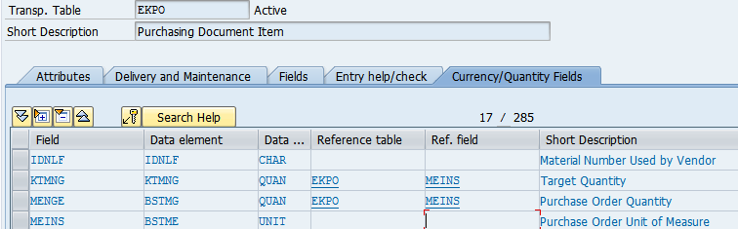
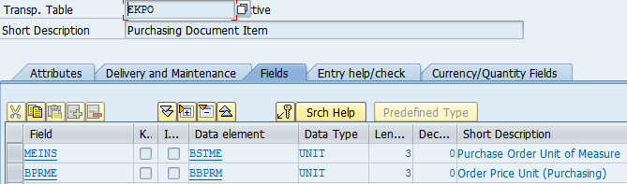
Tables
Quantities and Currencies Handling
Select Currencies/Quantity Fields
Fields KTMG & MENGE having data type of type QUAN
Reference field MEINS is assigned against above specified fields
MEINS field having data type UNIT

Slide 25
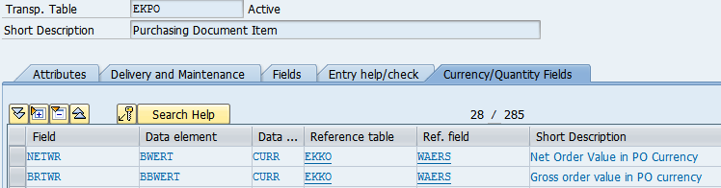
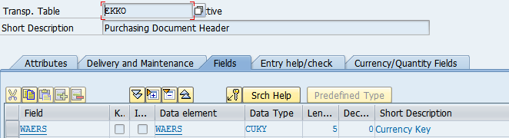
Tables
Quantities and Currencies Handling
Select Currencies/Quantity Fields
Fields NETPR & BRTWR having data type of type CURR
Reference field MEINS is assigned against above specified fields
WAERS field having data type CUKY

Slide 26
Tables
Foreign Key Relationship
Data Dictionary
Overview
Domain
Establishing relationship between two tables to validate entries in one table against other table.
Two Purposes:
Validation
Linking Tables
A foreign key links two tables T1 and T2 by assigning fields of table T1 to the primary key fields of table T2.
Table T1 is called the foreign key table (dependent table) &
Table T2 the check table (referenced table).
The pair of fields for the two tables must have the same data type and length.
Data Elements
Tables: Foreign Key Relationship
Table Maintenance
Views
Search Help
Lock Objects
structure

Slide 27
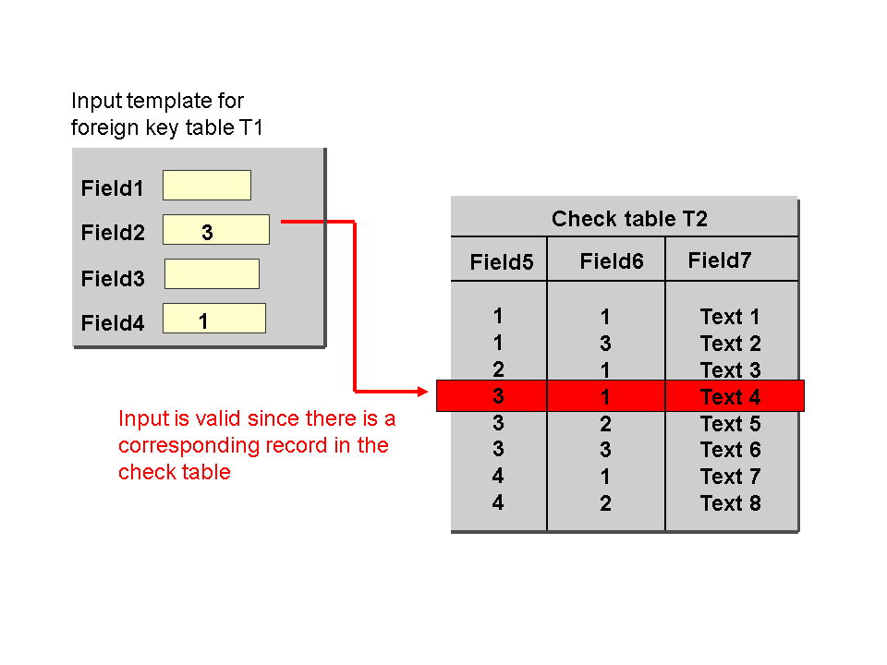
Tables
Foreign Key Relationship
Data Dictionary
Overview
Domain
A foreign key allows you to assign data records in the foreign key table and check table.
By using the entries in the foreign key fields, one record of the foreign key table uniquely identifies one record of the check table.
Data Elements
Tables: Foreign Key Relationship
Table Maintenance
Views
Search Help
Lock Objects
structure

Slide 28
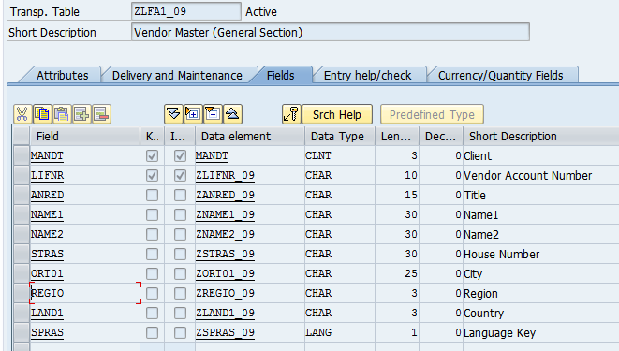
Tables
Foreign Key Relationship
Data Dictionary
Overview
We have table ZLFA1_09. LAND1 is country field.
In SAP, List of Countries will be available in T005 Table.
So we have to establish Foreign key between ZLFA1_09-LAND1 to T005-LAND1
Domain
Data Elements
Tables: Foreign Key Relationship
Table Maintenance
Views
Search Help
Lock Objects
structure

Slide 29
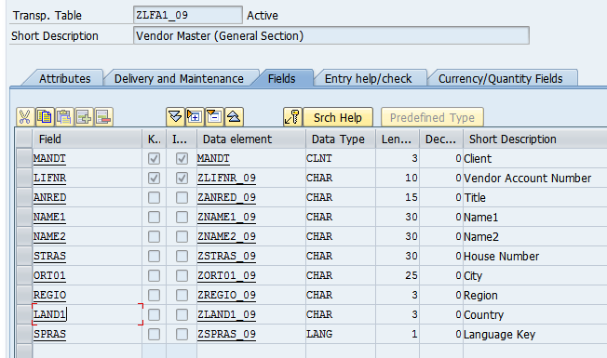
Tables
Foreign Key Relationship
Data Dictionary
Overview
2. Click on KEY button. Popup will be displayed
Domain
Data Elements
Tables: Foreign Key Relationship
Table Maintenance
Views
Search Help
Lock Objects
structure
1. Place the cursor on the field

Slide 30
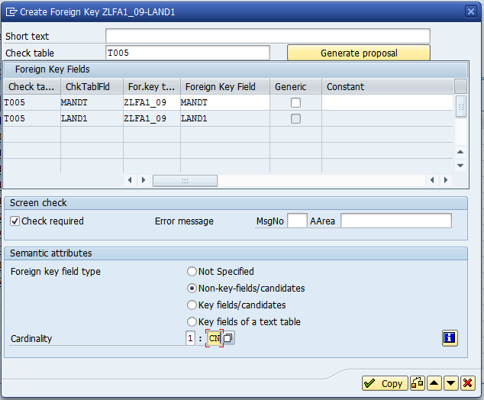
Tables
Foreign Key Relationship
Data Dictionary
Overview
Domain
Data Elements
Tables: Foreign Key Relationship
4. If system not proposed any table then we have to enter the table here
Table Maintenance
5. Enter Foreign key field type and Cardinality
Views
Search Help
Lock Objects
structure
SAP ABAP
30
6. Click on Copy Button

Slide 31
Data Dictionary
Table Maintenance Generator
Overview
Domain
It is generated program with one or two screens to allow the user to Insert/Modify/Delete values directly into the database table/Maintenance View.
Transaction to Maintain Entries: SM30
Create TMG for configuration tables which are having less number of fields
Data Elements
Tables
Table Maintenance
Views
Search Help
Lock Objects
structure

Slide 32
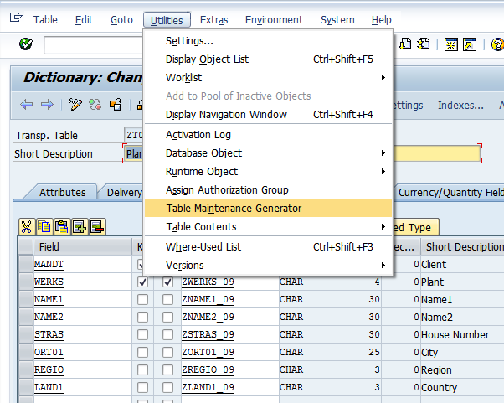
Table Maintenance Generator
Open Table in Change Mode
Click on Menu “Utilities”
Select Option “Table Maintenance Generator”

Slide 33
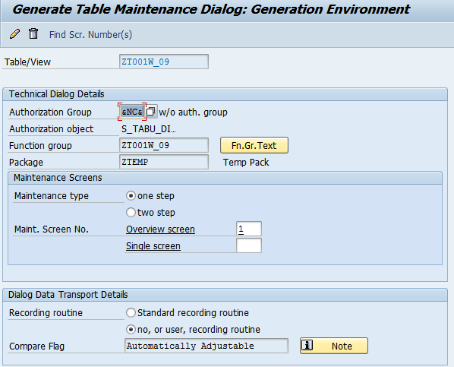
Table Maintenance Generator
4. Enter Authorization Group
Ex: &NC& - No Authorization
5. Specify Function Group Name. It can be same as table Name
6. Specify Maintenance Type and enter Screen Number (
One screen mode or Two Screen Mode.
If you select One screen mode then you can enter multiple records at a time
If you select two screen mode then you can enter only one record at a time
7. Choose Recording routine. If we select Standard recording routine, then TR is mandatory
If we select No, or User recording routine then TR is not required
8. Then Click on Create button on application toolbar

Slide 34
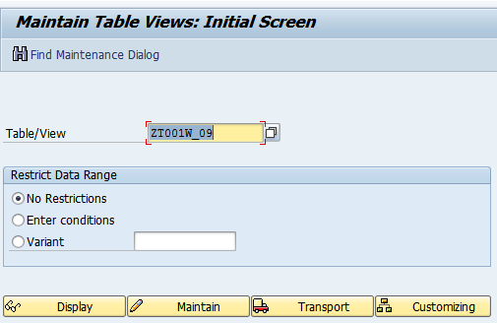
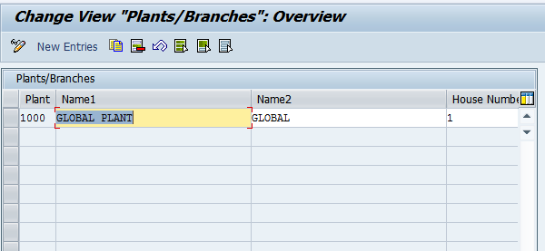
Table Maintenance Generator
Go to SM30 Transaction
Enter Table Name
Click on Maintain Button
Enter Values and save

Slide 35
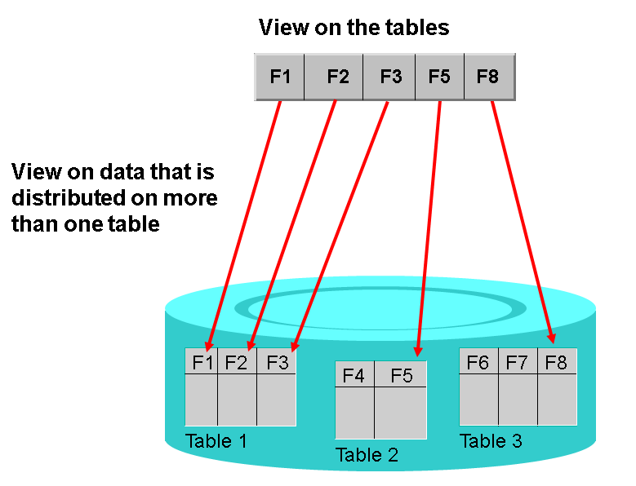
Data Dictionary
Views: Overview
Overview
Data about an application object can be distributed to several tables.
By defining a view, you can define an application-dependent view that combines this data.
The structure of such a view is defined by specifying the tables and fields used in the view
Fields that are not required can be hidden, thereby minimizing interfaces
Domain
Data Elements
Tables
Table Maintenance
Views: Overview
Search Help
Lock Objects
structure

Slide 36
Data Dictionary
Views: Overview
Overview
Domain
Types of Views
Projection View
Database View
Maintenance View
Help View
Data Elements
Tables
Table Maintenance
Views: Overview
Search Help
Lock Objects
structure

Slide 37
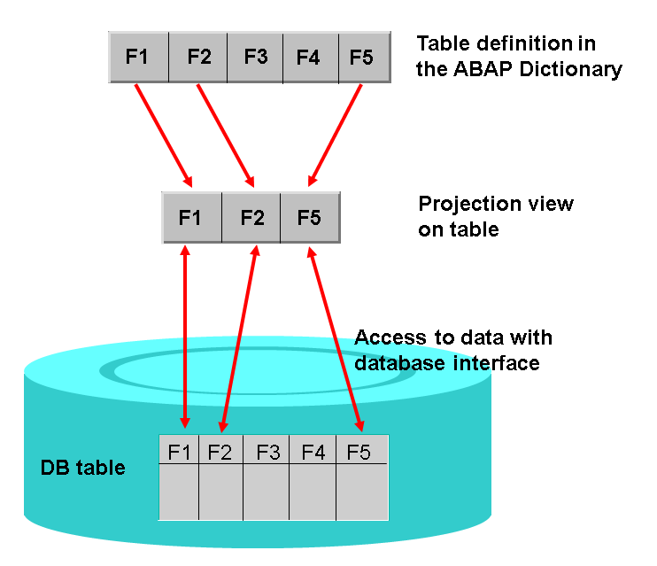
Data Dictionary
Views
Projection View
Overview
Domain
projection views to hide fields of a table. This can minimize interfaces
A projection view contains exactly one table. You cannot define selection conditions for projection views.
Data Elements
Tables
Table Maintenance
Views: Projection View
Search Help
Lock Objects
structure

Slide 38
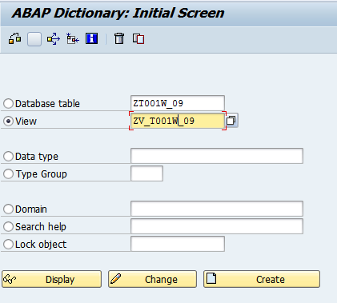
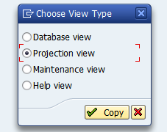
Views
Projection View
1. Select Radio Button View
2. Enter View Name
3. Click on Create Button
4. Select Project View Radio Button

Slide 39
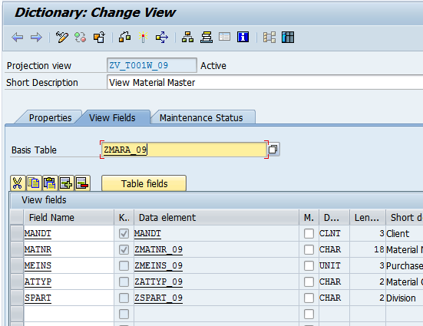
Views
Projection View
5. Enter Description
6. Select View Fields Tab
7. Enter Database Table Name
8. Enter required fields in the view

Slide 40
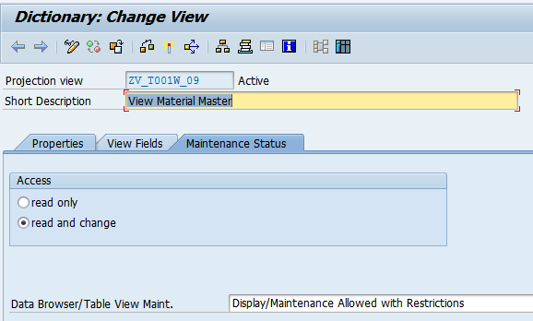
Views
Projection View
9. Select Maintenance Status tab
10. Select Access Mode
11. Specify Data Browser/Table View Maint Mode
12. Save and Activate

Slide 41
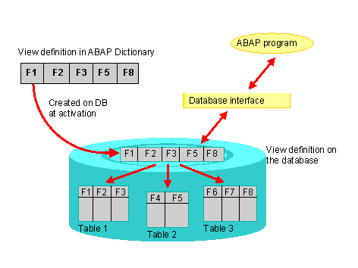
Data Dictionary
Views
Database View
Overview
Domain
Data about an application object is often distributed on several database tables. A database view provides an application-specific view on such distributed data.
Database views are defined in the ABAP Dictionary. A database view is automatically created in the underlying database when it is activated
Data Elements
Tables
Table Maintenance
Views: Database View
Search Help
Lock Objects
structure

Slide 42
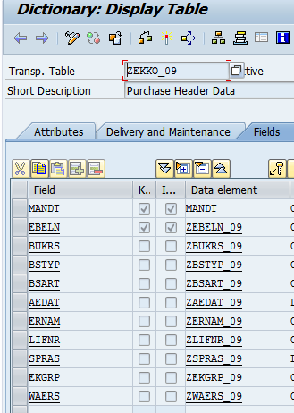
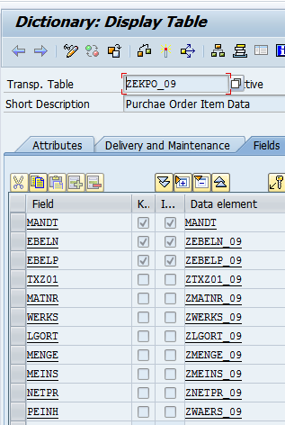
Views
Database View
Let us assume application data distributed among tables ZEKKO_09 and ZEKO_09
And both are linked via Foreign key relationship. Now requirement is to combine data somehow.

Slide 43
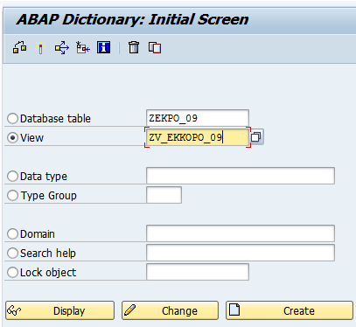
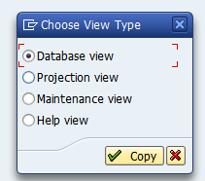
Views
Database View
1. Select Radio Button View
2. Enter View Name
3. Click on Create Button
4. Click on Database View Radio Button and Copy

Slide 44
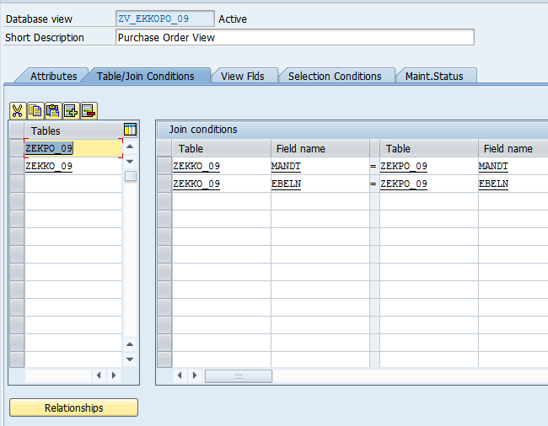
Views
Database View
5. Enter short Description
6. Enter list of tables to be joined. In our case only two tables joined
7. Enter Join Condition. Join condition automatically come when we click on Relationships button in the below and selectin the relation ship

Slide 45
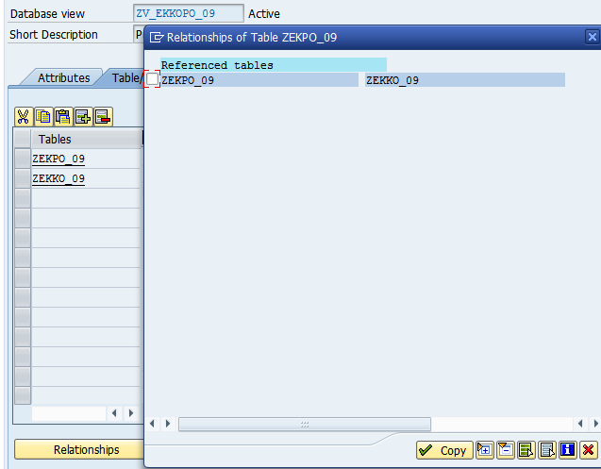
Views
Database View
9. Select the entry
8. Click on relationship button
10 . Click on Copy button
Whenever clicking on the Copy Button Join Condition automatically proposed

Slide 46
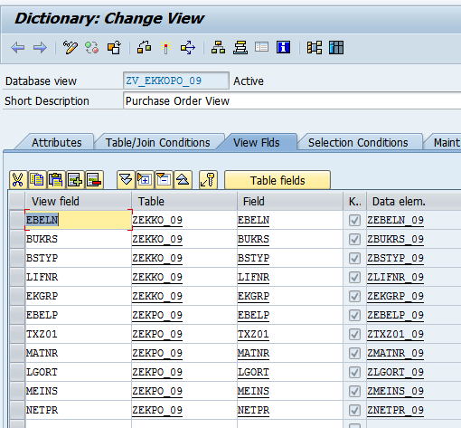
Views
Database View
11. Select View Fields Tab
12. Select required fields from both the tables
13. Save
14. Activate

Slide 47
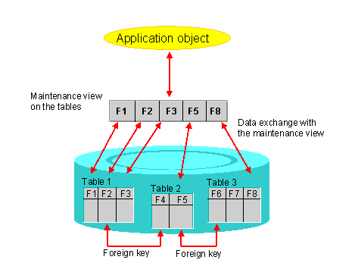
Data Dictionary
Views
Maintenance View
Overview
Domain
Data distributed on several tables often forms a logical unit. You want to be able to display, modify and create the data of such an application object together.
A maintenance view permits you to maintain the data of an application object together. The data is automatically distributed in the underlying database tables
Data Elements
Tables
Table Maintenance
Views: Maintenance View
Search Help
Lock Objects
structure

Slide 48
Data Dictionary
Views
Maintenance View
Overview
Domain
Maintenance view is combination of View and Maintenance Generator. It involves Two steps
Create a View of type Maintenance View
Create TMG for Maintenance View
Data Elements
Tables
Table Maintenance
Views: Maintenance View
Search Help
Lock Objects
structure

Slide 49
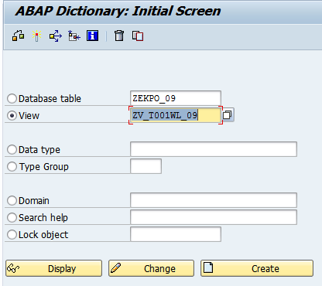
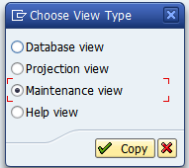
Views
Maintenance View
1. Select Radio Button View
2. Enter View Name
3. Click on Create Button
4. Click on Maintenance View

Slide 50
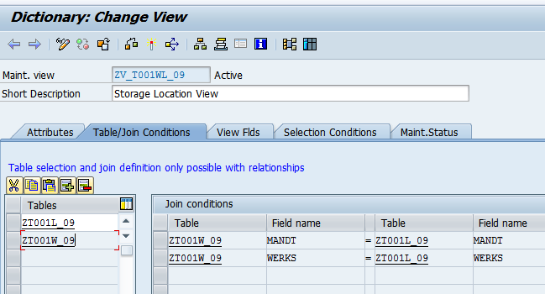
Views
Maintenance View
5. Enter Description
6. Select Table/Join Conditions
7. Enter Tables to be joined. Enter Foreign key table first and then enter check table by selecting Relation ship button in bottom.
Join Condition automatically proposed

Slide 51
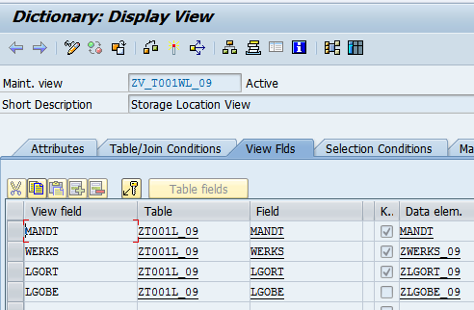
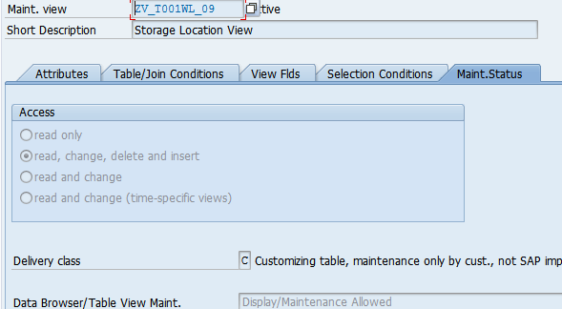
Views
Maintenance View
8. Select View Fields Tab and select required fields from each table
9. Select Maint Status Tab
10. Maintain following
Access
Delivery Class
Data browser and Table View Maint
11. Save And Activate

Slide 52
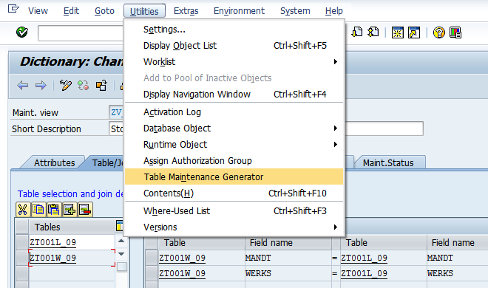
Views
Maintenance View
Next step is to create TMG for the Maintenance View
12. Select Menu Option Utilities and then select option Table Maintenance Generator
Note: While Creating View, we can choose single screen mode or two screen mode.

Slide 53
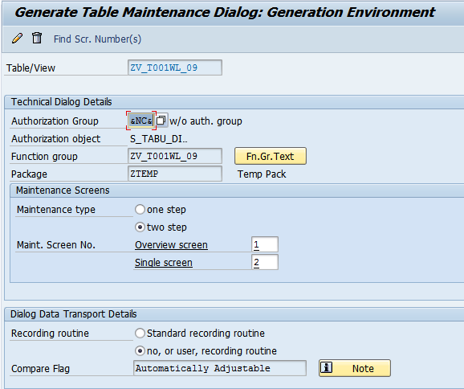
Views
Maintenance View
13. Specify Authorization Group
14. Specify Function Group
15. Specify Maintenance type as two step and enter two screen numbers
Then click on create button
Maintain entries in the view using transaction SM30

Slide 54

Data Dictionary
Search Help
Overview
Overview
Domain
Search helps are objects that you can use to assign input help (F4 Help) to screen fields.
You can do this by creating a search help in the ABAP Dictionary and attaching it to the corresponding screen field
Data Elements
Tables
Table Maintenance
Views: Maintenance View
Search Helps: Overview
Lock Objects
structure

Slide 55
Data Dictionary
Search Help
Overview
Overview
Domain
There are two types of search helps:
Elementary search helps
Collective search helps: Collective search helps combine several elementary search helps. A collective search help can offer several alternative search paths.
Search help is the database object to provide value help functionality. It involves following steps
Create search help
Assign Search Help
We can assign at Data Element Level
We can assign at Table Field Level
Data Elements
Tables
Table Maintenance
Views: Maintenance View
Search Helps: Overview
Lock Objects
structure

Slide 56

Data Dictionary
Search Help
Elementary Search Help
Overview
Domain
Example: when clicked F4 on Storage Location field in ME21N Transaction, Search help will be executed
Data Elements
Tables
Table Maintenance
Views: Maintenance View
Search Helps: Ele. Search Help
Lock Objects
structure

Slide 57


Search Help
Elementary Search Help
Note:
Standard Database table T005 contains list of countries. So we will create
Search help based on the T005 table
2. Enter name of Search Help
1. Select Radio Button Search Help
3. Click on Create Button
4. Click on Elementary Search Help

Slide 58

Search Help
Elementary Search Help
5. Enter Description
6. Enter Table Name
7. Enter Fields
IMP – Importing
EXP – Exporting
LPos- List Position
Spos- Selection Position
M – Modifiction
You will get to know everything when testing the search hep
8. Save
9. Activate

Slide 59


Search Help
Elementary Search Help
Click on execute Button
Testing Search Help
Whenever clicked on execute button, one popup screen appeared. This is called selection screen. Here Fields are arranged in a order in the order of SPos specification. Click on Enter

Slide 60

Search Help
Elementary Search Help
This is called output list. Order of field in the output list is same as LPos
This is called Search Help. Search help will fetch data from the table and display on popup screen. Now we have to use this search help where ever required

Slide 61

Search Help
Elementary Search Help
Assign Search help to the Data Element
Data Element: ZLAND_09.
Open Data Element in Change mode
1. Select Datatype Radio Button
2. Enter Data Element Name
3. Click on Change Button

Slide 62

Search Help
Elementary Search Help
6. Enter Field Name
7. Save and Activate
4. Select Further Characteristics Tab
5. Enter Search Help Name
So where ever the element used there it will give F4 help functionality

Slide 63

Data Dictionary
Search Help
Elementary Search Help
Overview
Domain
We can alter the behavior of the search help by implementing search help exit.
Data Elements
Tables
Table Maintenance
Views: Maintenance View
Search Helps: Ele. Search Help
Lock Objects
structure

Slide 64

Data Dictionary
Search Help
Collective Search Help
Overview
Combining multiple elementary search helps
Domain
Data Elements
Tables
Table Maintenance
Views: Maintenance View
Search Helps: Collective Search Help
Lock Objects
structure

Slide 65

Data Dictionary
Search Help
Collective Search Help
Overview
Example: Adding multiple search helps for the Material
Domain
Data Elements
Tables
Table Maintenance
Views: Maintenance View
Search Helps: Collective Search Help
Lock Objects
structure

Slide 66
Data Dictionary
Lock Objects
Overview
Overview
Domain
Synchronizes several users' simultaneous access to the same data records with a lock mechanism
Types of Locks
Shared Lock: User request for display - S
Exclusive Lock: User request for modify - E
Exclusive But not cumulative: allow the user to run single instance of transaction - X
Optimistic Lock It is behaves as shared lock initially later it will be converted as Exclusive Lock - O
When you activate a lock object in the ABAP Dictionary, the system automatically creates function modules for
-> Setting (ENQUEUE_<lock object name>) and
-> releasing (DEQUEUE_<lock object name>) locks
But Why Lock Object:? What is Consistent state of the database?
Data Elements
Tables
Table Maintenance
Views: Maintenance View
Search Helps
Lock Objects: Overview
structure

Slide 67

Lock Objects
Overview
Go to transaction SE11 and click on Lock Object Radio Button
Enter Lock Object Name
Click on Create Button

Slide 68

Lock Objects
Overview
Enter Description
Select Table Tab
Select Table Tab
Select Lock Mode

Slide 69

Lock Objects
Overview
Select Lock Parameter Tab
Select Table Tab
Note: System automatically propose all the key fields of the table as Lock parameters.
We add additional fields as lock Parameters or can remove existing proposed fields
Save and Activate

Slide 70
Data Dictionary
Structure
Overview
Overview
Domain
Structure is one of the database object to combine logically related fields.
Structure are reusable component so We can include this structure in several tables.
.INCLUDE is the statement to include structure in Table
We can also use structure in ABAP programs to declare work areas
It looks like Table but
No Delivery and Maintenance
No Technical Settings
No Foreign Key relationships
It does not holds any data
Data Elements
Tables
Table Maintenance
Views: Maintenance View
Search Helps
Lock Objects: Example
Structure

Slide 71


Structure
Overview
Go to Transaction SE11
Select Datatype Radio Button
Enter Structure Name
Select Table Tab
Select Structure Radio Button

Slide 72

Structure
Overview
Enter fields and data types

Slide 73

Structure
Overview
Include the structure in table
Structure ZADDRESS_09 included in the ZLFA1_09 table using .INCLUDE

Slide 74
Data Dictionary
Data Dictionary
Miscellaneous
Overview
Domain
There are few other concepts in Data Dictionary
Text Table
Database Utility
Version Management
Data Elements
Tables
Table Maintenance
Views: Maintenance View
Search Helps
Lock Objects: Example
Structure
Miscellaneous

Slide 75


Data Dictionary
Data Dictionary
Miscellaneous: Text Table
Overview
Text Table:
Text table is a table to maintain language specific text to the entries of check table
Ex: MARA – Material Master Data
MAKT – Language specific text for Each Material
Rule:
Key fields of the Text table are
1. All Key fields of Check table and
2. Language field SPRAS
Domain
Data Elements
Tables
Table Maintenance
Views: Maintenance View
Search Helps
Lock Objects: Example
Structure
Miscellaneous: Text Table

Slide 76
Data Dictionary
Data Dictionary
Database Utility
Overview
Domain
Database Utility is used to carry the changes in the table from Data Dictionary to Underlying Database.
When you make any changes to key fields in the table then it is necessary to run the database utility to adjust the tables in the underlying database tables.
Changes for the Key fields include
Making non key fields as key fields
Making key fields as non key fields
Changing data type of the key fields
Data Elements
Tables
Table Maintenance
Views: Maintenance View
Search Helps
Lock Objects: Example
Structure
Miscellaneous: Database Utility

Slide 77

Data Dictionary
Data Dictionary
Database Utility
Overview
Domain
Go to Transaction: SE14
Data Elements
Tables
Enter Table Name
Table Maintenance
Views: Maintenance View
Search Helps
Lock Objects: Example
Click on Edit Button
Structure
Miscellaneous: Database Utility

Slide 78

Data Dictionary
Data Dictionary
Database Utility
Overview
Database utility is not for regular use. Whenever there is a problem with the
Table then only we will check here.
Domain
Data Elements
Tables
Table Maintenance
Views: Maintenance View
Search Helps
Lock Objects: Example
Structure
Miscellaneous: Database Utility

Slide 79
Data Dictionary
Data Dictionary
Database Utility
Overview
Database utility is not for regular use. Whenever there is a problem with the
Table then only we will check here.
Database utility is used to create table at Database level. Generally whenever
We activate the table in SE11 then automatically system will create in the under
Lying database.
3 kinds of Processing types available here
Domain
Data Elements
Tables
Table Maintenance
Views: Maintenance View
Processing Types
Search Helps
Lock Objects: Example
Structure
Miscellaneous: Database Utility

Slide 80
Data Dictionary
Data Dictionary
Database Utility
Overview
If we make any changes to key fields of the table then sometimes it is necessary
To adjust the table in the underlying database table through SE14 Transaction
Domain
Data Elements
Tables
Table Maintenance
Views: Maintenance View
Search Helps
Save Data: when you made any changes to the table and if table contains entries then you have to go for this option to retain data in the table
Delete Data: when you don’t want any entry from the table then you can choose while adjusting table
Lock Objects: Example
Structure
Create database Table: this button enabled only when table does not exists in the database
Delete database table: if you want to create a table at database then we go for this option
Activate and Adjust database: when table not activated properly from SE11 then we will choose this option to activate at database level
Miscellaneous: Database Utility

Slide 81

Data Dictionary
Data Dictionary
Version Management
Overview
Domain
Version Management is used to identity the changes in the table
Data Elements
Tables
Table Maintenance
Views: Maintenance View
Search Helps
Lock Objects: Example
Structure
Miscellaneous: Version Management

